Slide 1
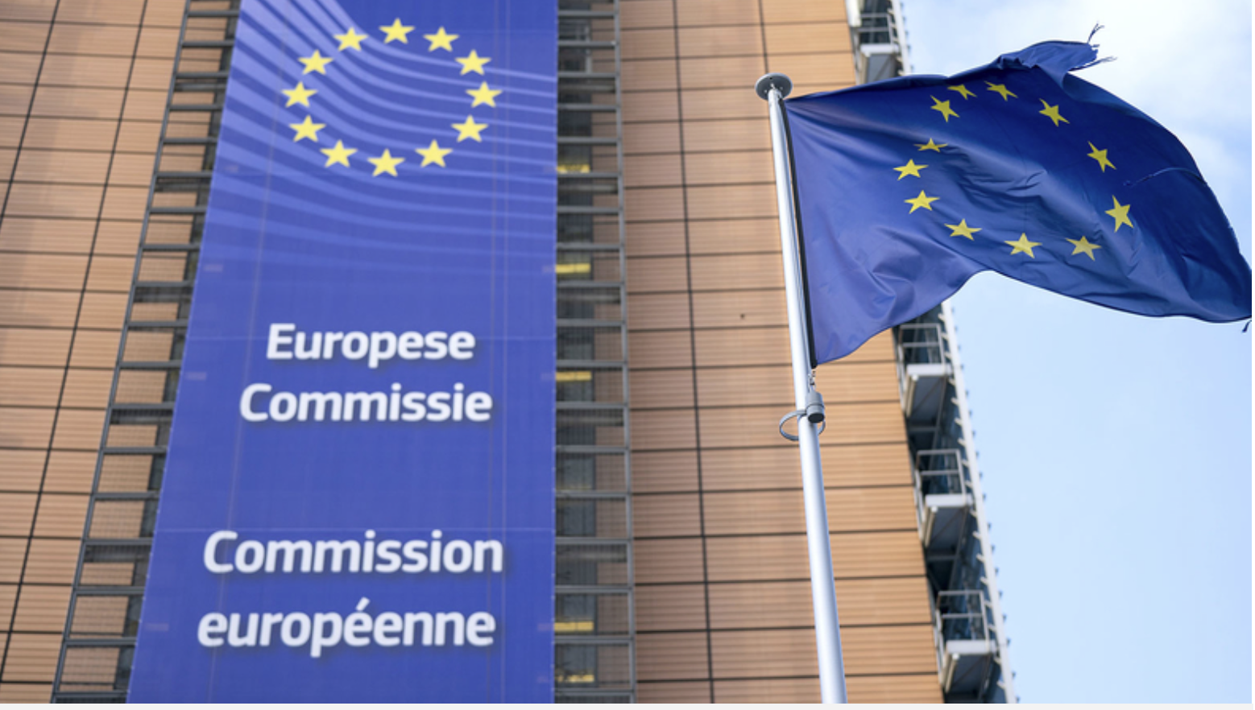


Predicting European M&A Regulatory Outcomes
Notes:
Good morning, Id like to thank the Managing Partners of the law firm of Metis, Ridge & Lasso for the opportunity to present here today and highlight how our data science team at DS Consulting can aid your firm in better advising it’s mergers and acquisition clients. As we all know the landscape of m&a is one of high stakes, and ill-conceived mergers that don’t lead to consummation can be very expensive for your clients

Slide 2
COST OF FAILED MERGERS
01
Opportunity Cost of Time
02
Loss of Focus
03
Legal Expenses
04
Reputational Damage
05
*** Reverse Break-Up Fees ***
Notes:
The cost can vary in type & scope, however the most notable of these costs are reverse break-up fees..which as we all know are fees paid by the acquirer to the target company if they are unable to gain regulatory approval of the merger, which of course is the subject matter of today’s presentation

Slide 3






REVERSE BREAK-UP FEES
ACQUIRER | TARGET
DEALSIZE | FEE SIZE
$39 billion | $6 billion
$68 billion | $ 4.5 billion
$130 billion | $1.25 billion
Notes:
Here are some of the biggest reverse break-up fees in history, you’ll see that At&ts failed acquisition of T-mobile, resulted in the largest ever break-up free of $6billion. Now in order to help guard against these costly pitfalls we at DS consulting believe we can use advanced statistical methodologies in enabling your firm to better predict the likelihood of positive or negative outcome for your clients even before an acquisition is initiated

Slide 4


DATA
EU Merger Control Database
Maintained by Directorate-General of Competitions of European Commission
5,196 Observations
1990 -2014
26 Features
4 - Quantitative
21 - Categorical
Data Acquisition/Cleaning
Notes:
We have chosen to focus on the european m&a landscape as this is one of your firms biggest markets and it provides us with a reasonable amount of data in the form of the EU Merger Control database which is maintained by the european commisson. The database includes 5000+ mergers that occurred between 1990-2014...we filtered it down to 26 features, 4 quantitative and 21 categorical….in terms of our data acquisition, cleaning we used google sheets

Slide 5
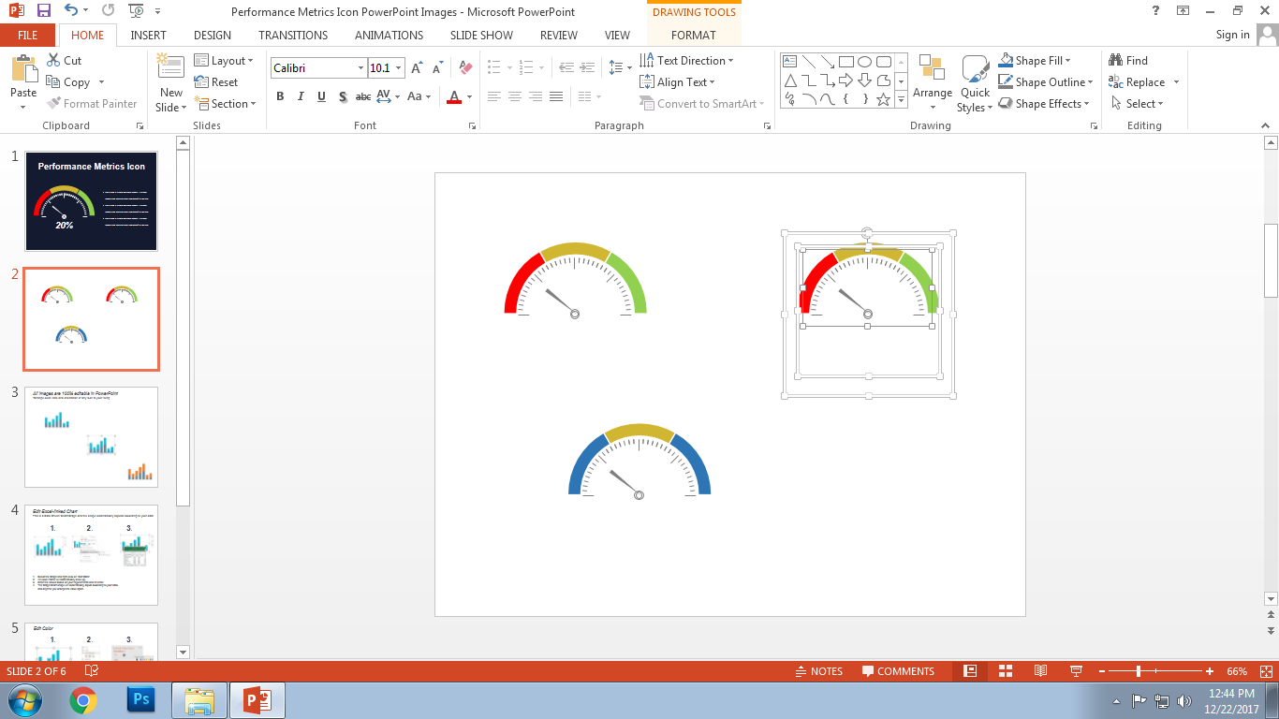


MODELING
Classification
Logistic Regression
0
1
OUTCOME A
OUTCOME B
EDA:
Visualizations:
Notes:
We believe the most appropriate scheme for this problem would be a classification model, specifically we will be using an algorithm known as logistic regression which essentially evaluates binary qualitative outcomes by using a scale of 0 to 1 to represent an implied likelihood of each outcome, depending on a pre-specified threshold that we would set. For our EDA we used google sheets and to visualize our insights we used tableau…... now in this case our outcomes are actually not binary, there are in fact numerous phases within the regulatory approval process where applications can either accepted, prohibited, asked to be modified with certain remedies or put through more intense scrutiny

Slide 6
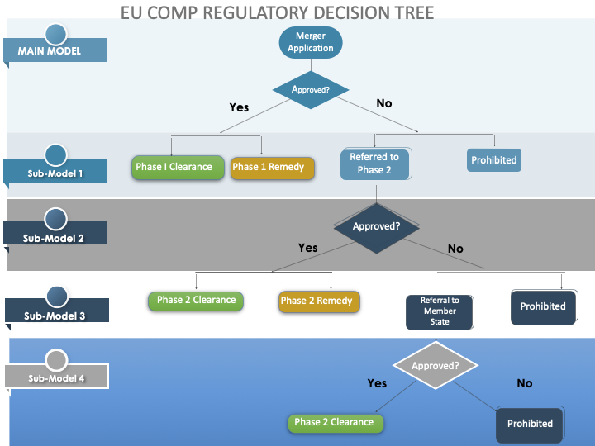
Notes:
So the way we chose to handle this was a multi-stage, multi-model approach. If we look at this flow chart we see the various phases of the approval process highlighted by color. There very first stage will be where run our main, overarching model that will give us the implied probability of an overall approval or disapproval. Regardless of the outcome, we will then run a secondary sub-modell. Now, for example, if the merger is approved or prohibited in phase 1 we can stop there, if it referred to phase 2 we would execute a 3rd model and so on and so forth until a final verdict is reached. This method also gives us the ability to relative correlation of features at each stage of the process by monitoring the changes in coefficients

Slide 7
PROMINENT FEATURES
PROMINENT FEATURES
COMPETITIVE
PROFILE
Competitive
Productivity
Herfindahl Index
Industry Type
Herfindahl-Index
Industry Type
Competitive Concerns
Vertical v Horizontal
Number of Competitors
Country of Acquirer/Target
Barriers to Entry
Decision Year
Land and Infrastructure
Combined Market Share
Competitive Concerns
Geo Market
Complexity
Technology, Management and Information
Notes:
It terms of features we divided them into 2 broad categories. As we know the biggest concern of most merger regulators is maintaining a competitive market place, so we focused on features that attempt to quantify competitive nature of an industry, such as number of competitors or barriers to entry

Slide 8
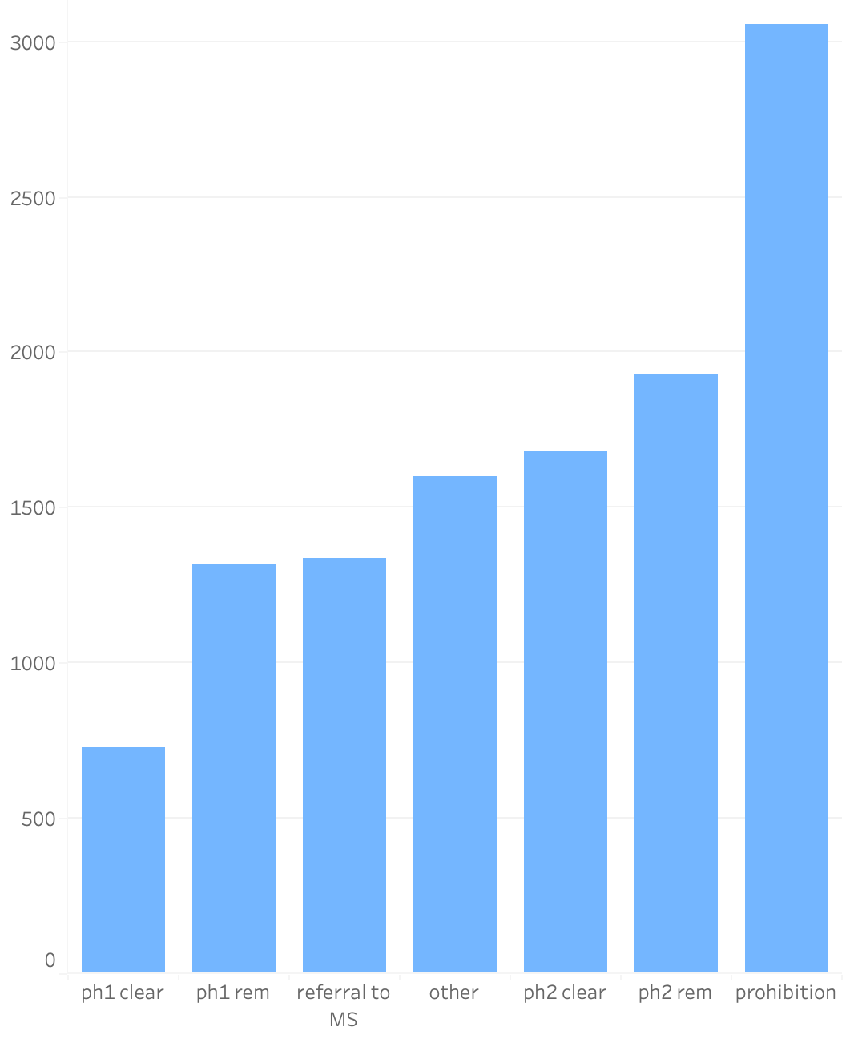
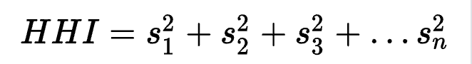
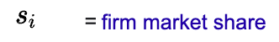
Herfindahl-Hirschman Index(HHI)
INDEX LEVEL
Scale: 0 to 10000
HHI < 1,500: Competitive
1500 < HHI < 2500: Moderate
HHI > 2500: Concentrated
Type of Outcome
Notes:
One of these competitive features we are going to look at is the Herfindahl-Hirschman Index, which as we know is a commonly used measure of market concentration, that is, the more concentrated an industry the less competition there is. The index is calculated by taking the sum of the squared market share of each company in the industry..the scale of the index is from 0 to 10000…. anything over 2500 is considered a highly concentrated industry...if we look at the graph we see the average HHI of past merger applications of each regulatory outcome. Notice that mergers that were cleared in the early phases such phase 1 had the lowest average HHIs, whereas, mergers that were prohibited had the highest average HHIs

Slide 9
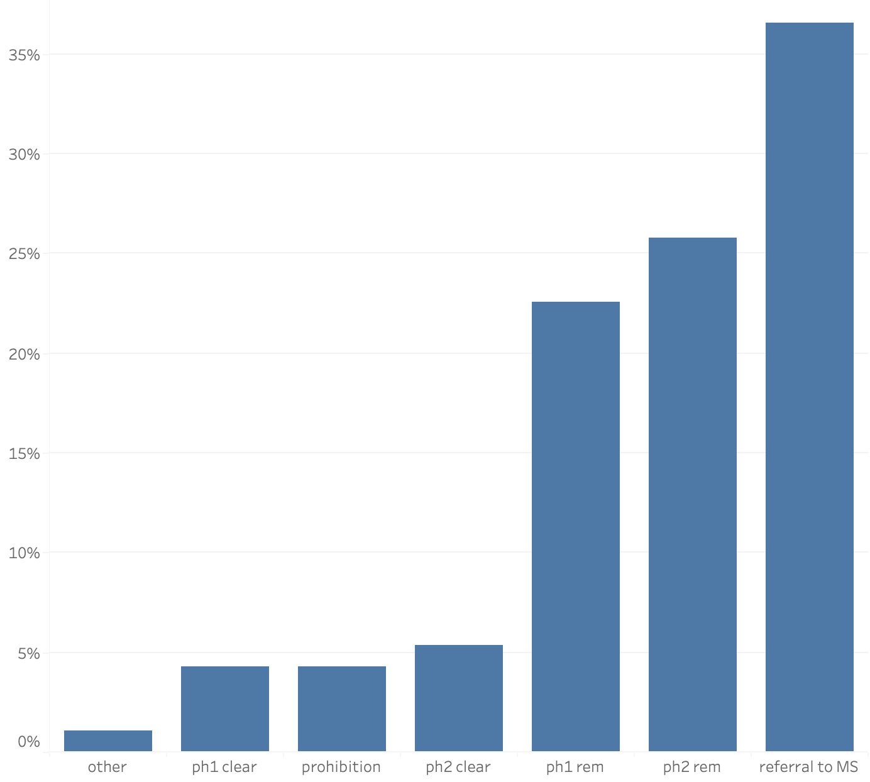
Competitive Concerned Mergers by Outcome
% of All Competitive Concerned Mergers
Type of Outcome
Notes:
Another more direct measure of competition comes directly from Commision itself, in the form of a categorical feature named Competitive Concern in which 1 is used in the dataset to represent competitive concerns by the commission and zero is used to represent a lack of competitive concerns. Notice that only approximately 3% of competitively concerned mergers are cleared in the early phases but a over 20% of concerned mergers require a remedy in phase 1 or 2.

Slide 10
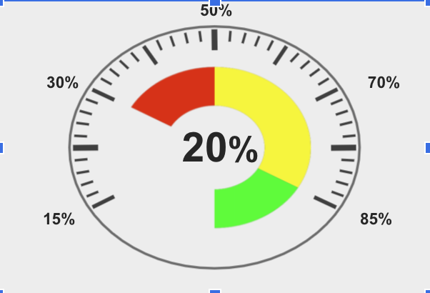
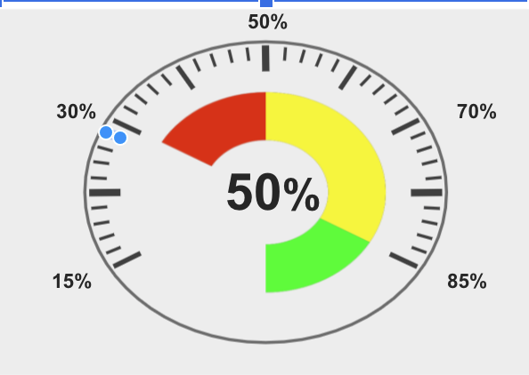

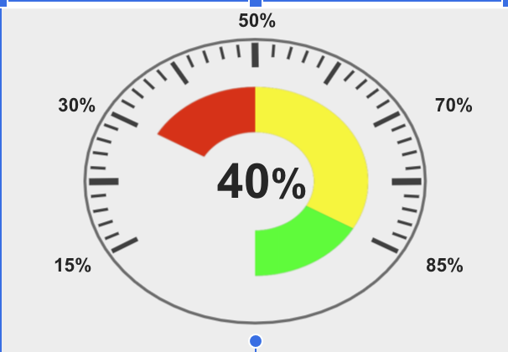
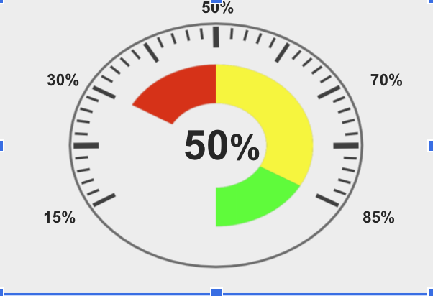
MEASURES OF SUCCESS
Metric | Target
SUB-MODEL 1 Phase 1 Clearance/Total Client Apps
SUB-MODEL 2 Phase 2 Approval/Clients Referred to Phase 2 | Text Here
Sub-Model 3 Phase 2 Clearance/Clients Approved in Phase 2 | Text Here
Sub-Model 4 Clearance by MS/Total Client Application Referred to MS | Text Here
MAIN MODEL
Approved Clients/Total Client
M&A Applications
Notes:
In term of metrics...our main model as we see on the right is simply evaluated as the total number of approved applications as a percentage of total client applications...we would like to aim for a 50% increase in this overall metric...however, we are cognizant of the fact that you as lawyers are paid by the hour and decisions at an early stage of the process, while positive for the client also result in less legal fees. So we adjusted our metrics to aim for slightly less increases of approvals in the early phases of the process,namely to 20-25%, whilst increasing our targets in the later stages of the process to 40-50%. We belief this will strike the right balance in serving your clients whilst maintaining an acceptable level of fee revenue. If our model does result in very high levels of approvals in the early phases, keep in mind that this can be offset with clients rewarding the firm with business in its other disciplinary specialities or the attraction of new clients that hear about the success of our model

Slide 11
Expand Existing Database
Include Competitors
Future Work
Focus on the United States
Fine Tune Metrics
Interview Regulators
Notes:
In term of future work, amongst other things we would like to expand our existing database of european mergers to include transactioins from 2015 to 2021, we’d also like to include more information on competitors , and of course expand our model to the United states

Slide 12
APPENDIX

Slide 13
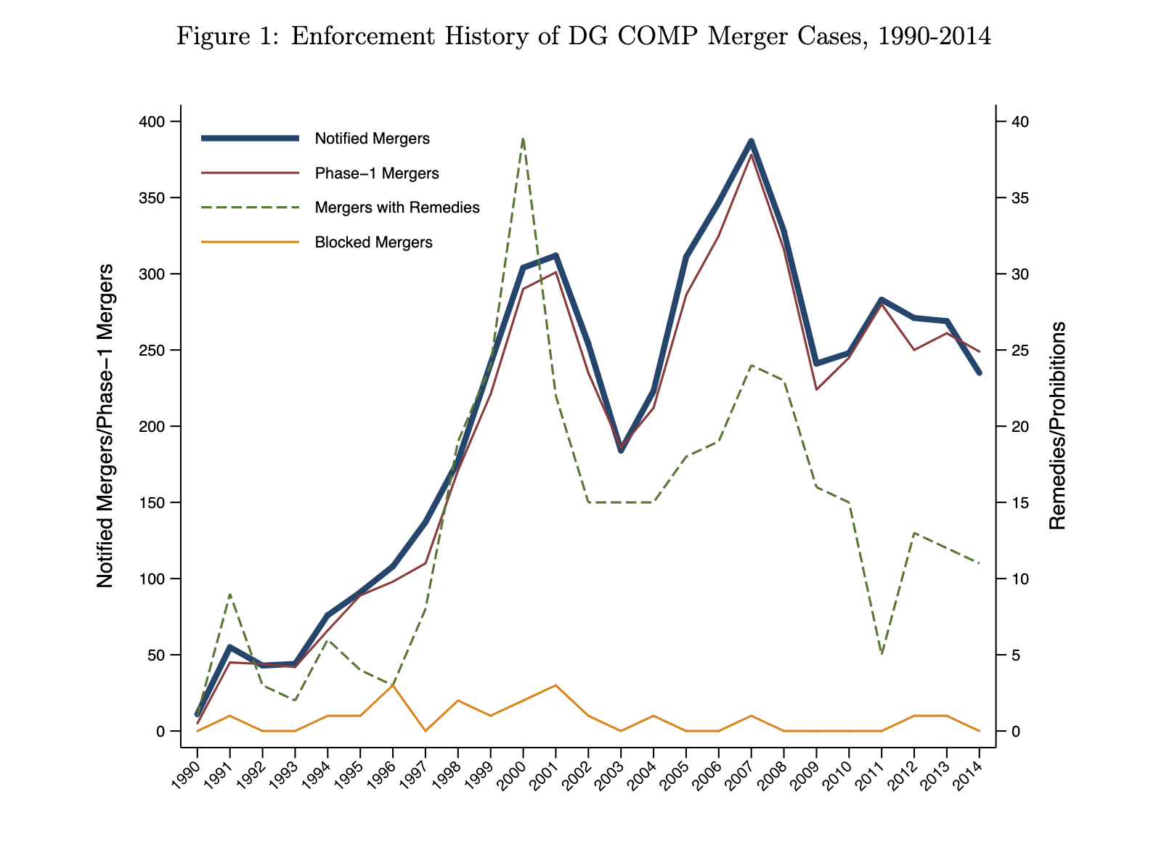

Slide 14
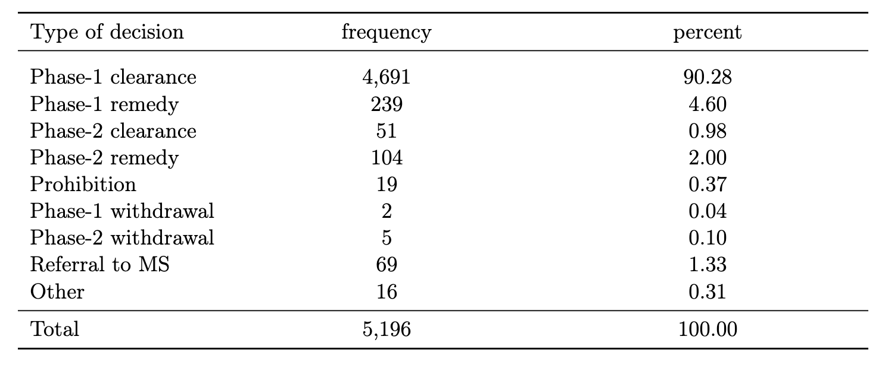
Frequency Distributions of Outcomes

Slide 15
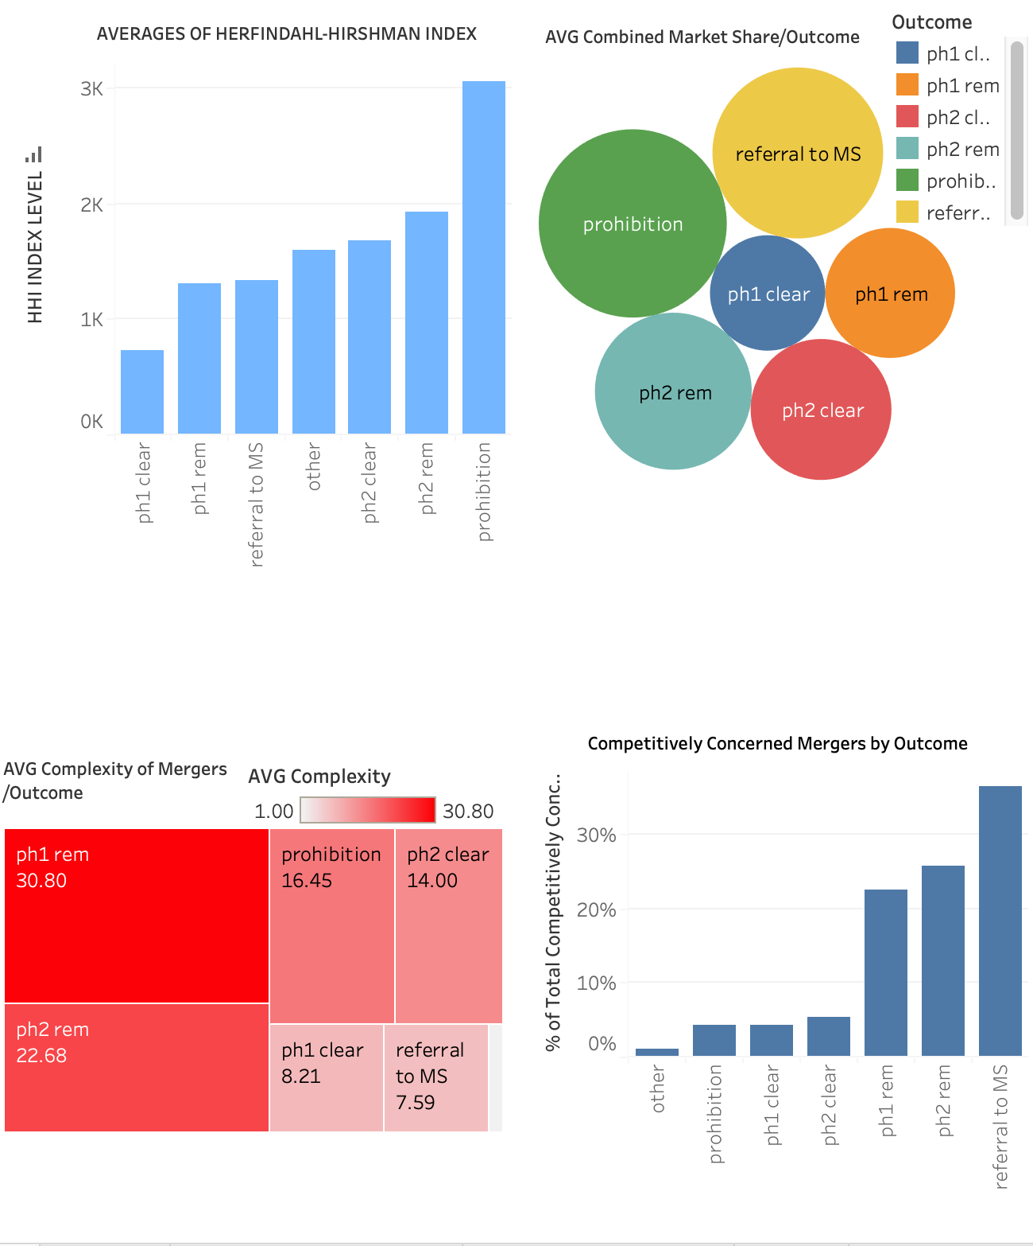
Tableau Dashboard Overview

Slide 16
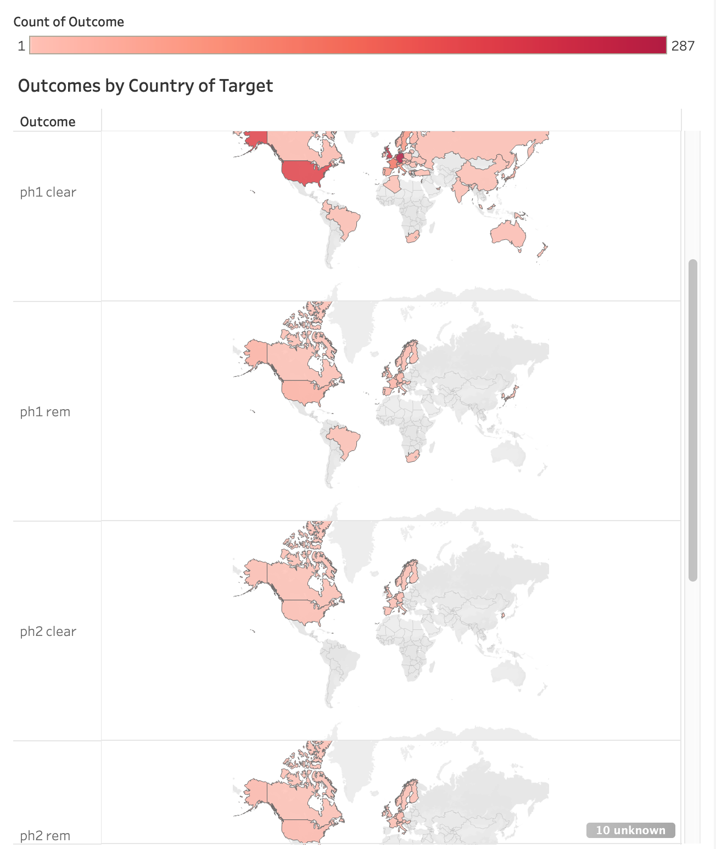
Merger Outcome Distribution Map

Slide 17
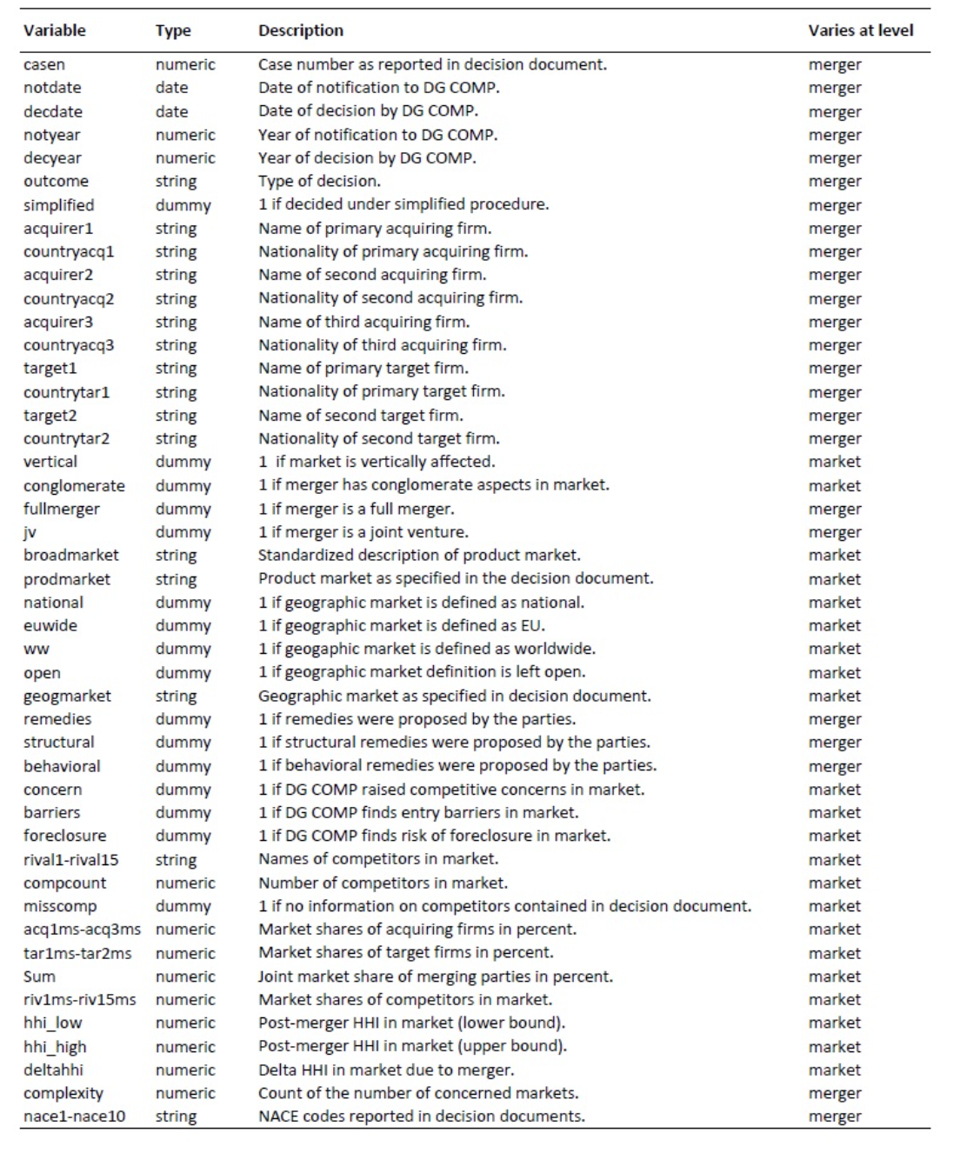
Database Variables Key

